Slide 1
Bank management system
Submitted for partial fulfillment for award for degree
M.C.A (master of computer apllication)
Subject name:- project report & viva
Submited by :-
Ms. Bhairavi nitin patil
Ms. Rina kailas mali
Ms. Bhairavi shantaram patil

Slide 2
P roject memeber
Bhairavi Nitin patil
Link on github:- https://github.com/bhairavipatil10/bank_mamngement_system

Slide 3
Contents
Software process of using agile methodology
Introduction
Objective of BMS
Structure of BMS
Requirements of BMS
Future scope of BMS

Slide 4
Introduction
The Bank Management System (BMS) Is A Web-based Application Used For Paying Financial Institutions For The Services They Provide To The Bureau Of The Fiscal Service. BMS Also Provides Analytical Tools To Review, And Approve Compensation, Budgets, And Outflows.

Slide 5
Software process using agile methodology
Agile development methodology
Teams use the agile development methodology to minimize risk (such as bugs, cost overruns, and changing requirements) when adding new functionality. In all agile methods, teams develop the software in iterations that contain mini-increments of the new functionality. There are many different forms of the agile development method, including scrum, crystal, extreme programming (XP), and feature-driven development (FDD).
Pros: the primary benefit of agile software development is that it allows software to be released in iterations. Iterative releases improve efficiency by allowing teams to find and fix defects and align expectation early on. They also allow users to realize software benefits earlier, with frequent incremental improvements.

Slide 6
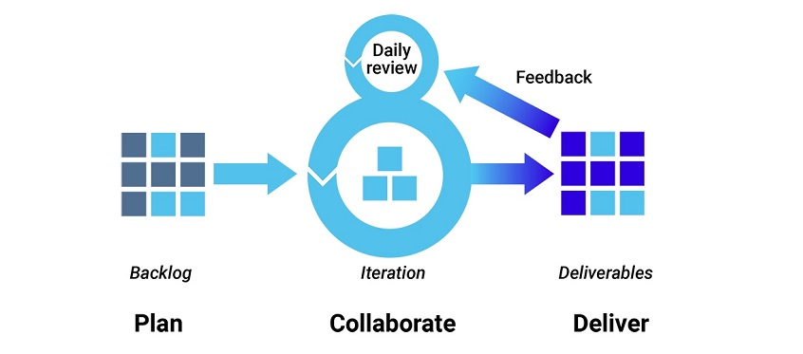
Cons: Agile development methods rely on real-time communication, so new users often lack the documentation they need to get up to speed. They require a huge time commitment from users and are labor intensive because developers must fully complete each feature within each iteration for user approval. Agile development methods are similar to rapid application development (see below) and can be inefficient in large organizations. Programmers, managers, and organizations accustomed to the waterfall method (see below) may have difficulty adjusting to an agile SDLC. So a hybrid approach often works well for them.
n

Slide 7
Objective BMS
The Bank Management System (BMS) Is A Web-based Application Used For Paying Financial Institutions For The Services They Provide To The Bureau Of The Fiscal Service. BMS Also Provides Analytical Tools To Review, And Approve Compensation, Budgets, And Outflows.

Slide 8
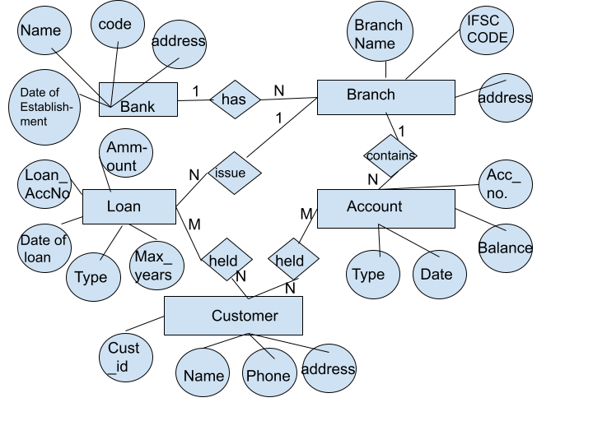
Structure of BMS

Slide 9
Requirements of BMS
Security. ...
Performance. ...
Usability. ...
Availability. ...
Customers Relation Stores Information About Bank Clients, Each Of The Customers Can Have Multiple Balance Accounts And Loans.

Slide 10
Future Scope BMS
Customers Can Create New Accounts Using The Application. The Customers Can Choose Between A Savings Account Or Current Account. This Application Saves Customers The Hassle Of Visiting The Bank To Create Or Use These Accounts.
Depositing Money – With The Global Shift Towards Paper Currency Being Less Common, It Will Be As Simple As Clicking A Few Buttons On This App To Deposit Or Transfer Money Between Banks.
Withdrawing Money – You Can Also Send Requests Through The Application For Money Transfers.

Slide 11
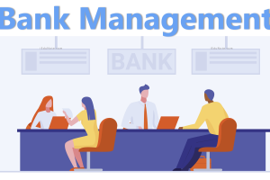
Bank management system

Slide 12


